Slide 1

IBM SkillsBuild for Adult Learners - Front-end Web Development
Front-end Web Development Internship Program 2024 Final Project Presentation
Project Name : MaseryMate Team Name : Code Crafters
College Name : Government Engineering collage, Modasa

Slide 2
Team Members :-
Chudasama Hetvi Ajaykumar
Valand Dharaben Shubhashbhai
Bhayani Nemish Prafulbhai
Dhimmar Yash Dipakbhai

Slide 3
Introduction
Mastery Mate is an online platform designed to connect homeowners and DIY enthusiasts in India with skilled professionals.
It addresses challenges like finding qualified professionals, unverified skills, unclear pricing, and security concerns.
Provides DIY resources and a culturally sensitive platform tailored to the Indian market.

Slide 4
Requirements Gathering
Key Features and Functionalities :
1. User Profiles
2. Search and Discovery
3. Transparent Pricing
4. Booking and Scheduling
5. Ratings and Reviews
6. Secure Communication
User Requirements:
1. Homeowners
2. Service Providers
Stakeholder Inputs
1. Platform Administrators
2. Investors
3. Service Providers
4. Homeowners

Slide 5
Problem Identification
Limited Discovery: Difficulty finding qualified professionals.
Unverified Skills: Uncertainty about the experience of service providers.
Unclear Pricing: Inaccessibility to upfront cost estimates.
Security Concerns: Risks associated with inviting unknown individuals into homes.

Slide 6
Wireframing and Prototyping
Wireframes
Home Page
Service Provider Profile
Booking Page
User Dashboard
Prototype Tools Used
Figma
Adobe XD
Sketch

Slide 7
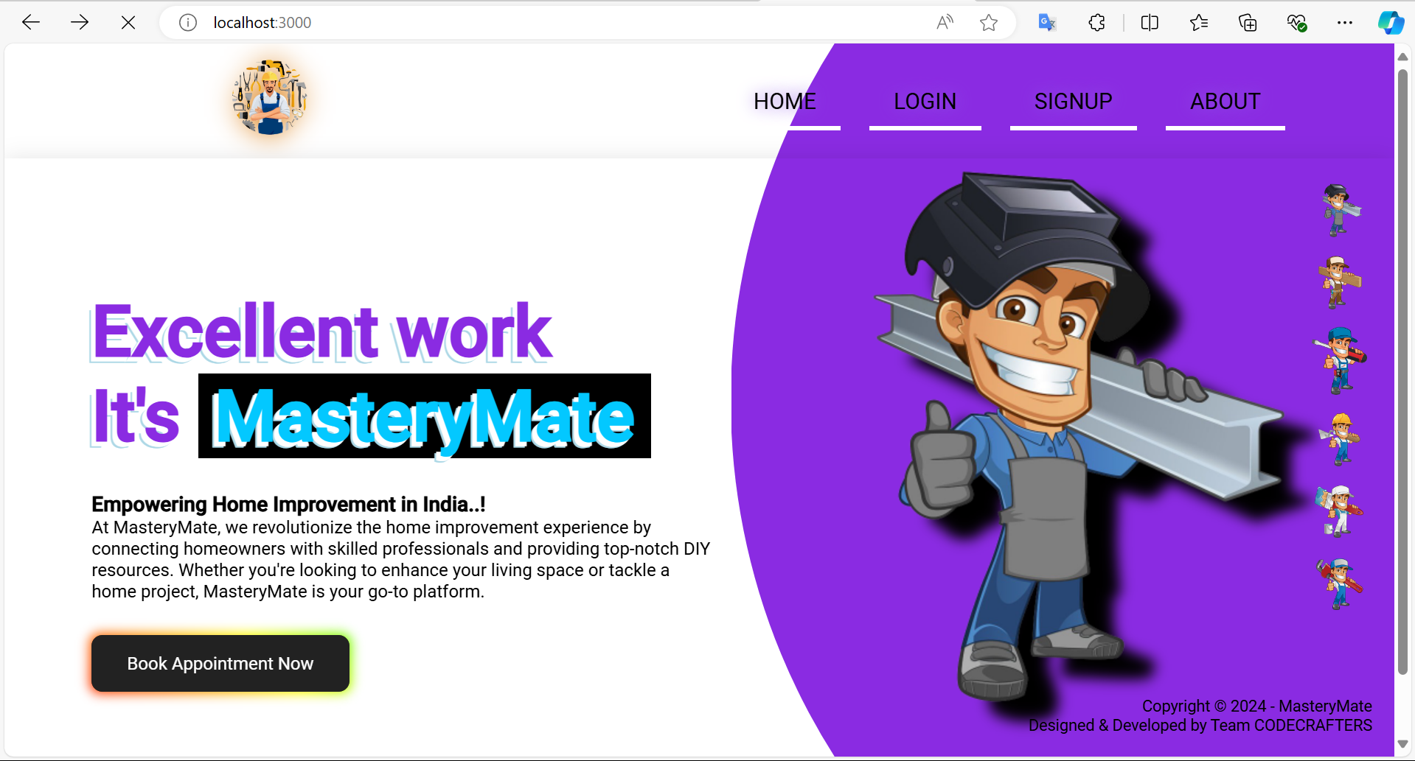
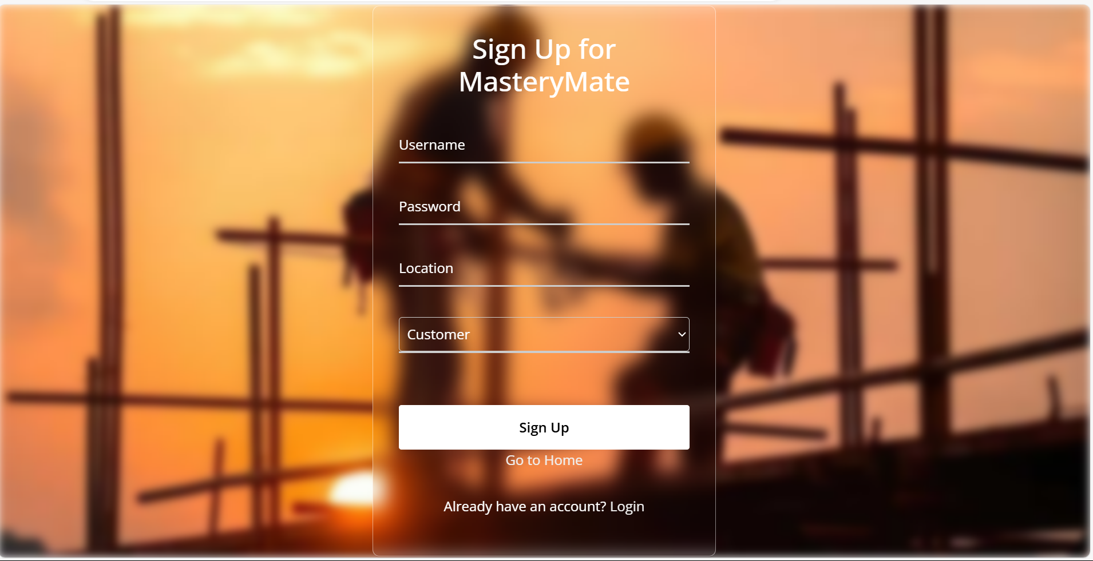
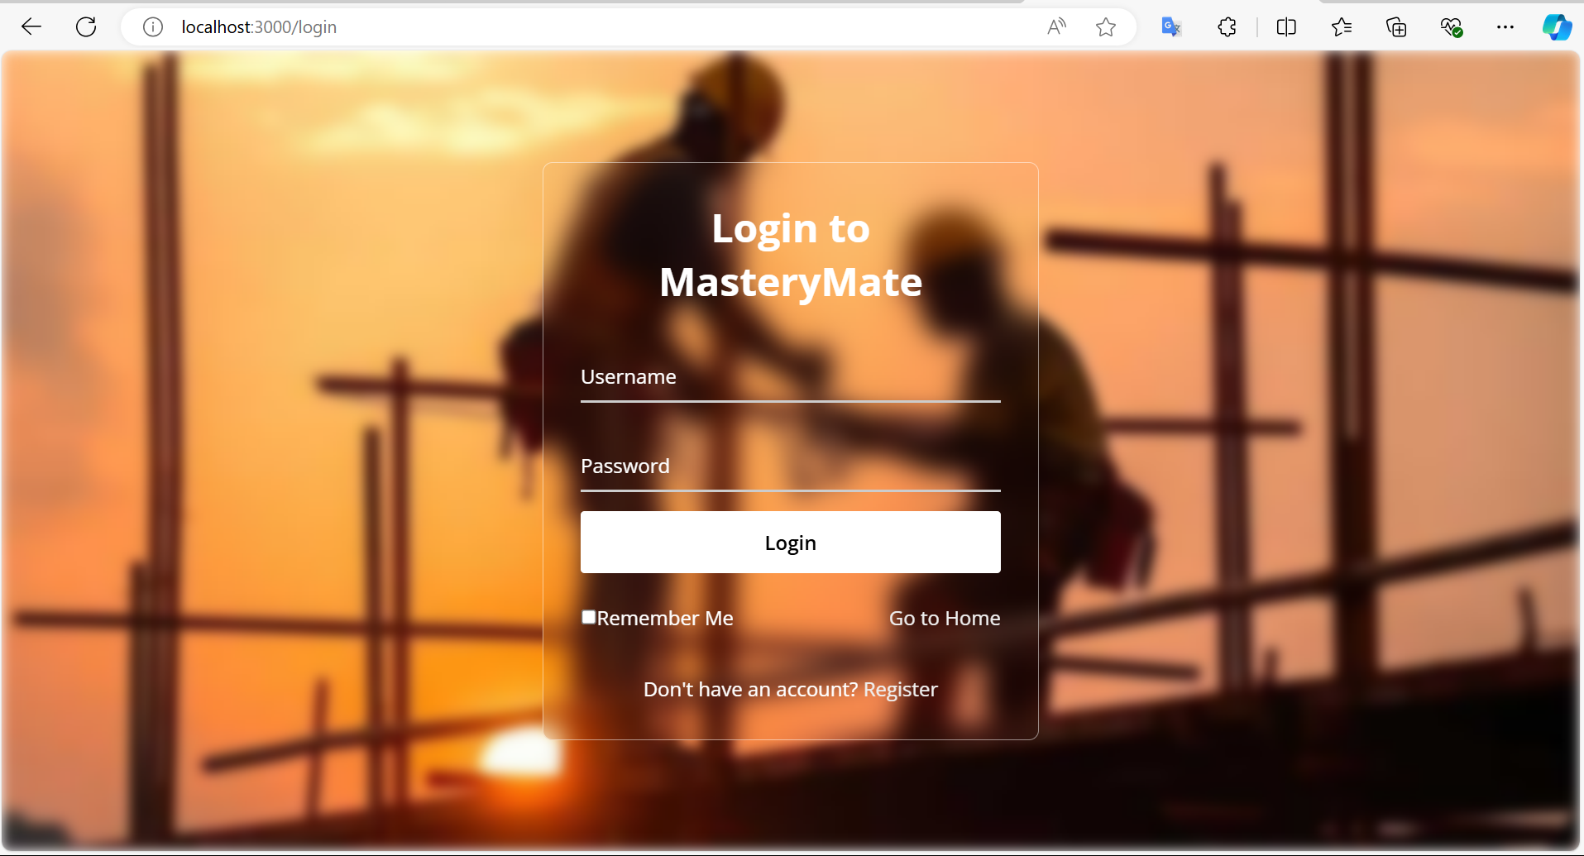
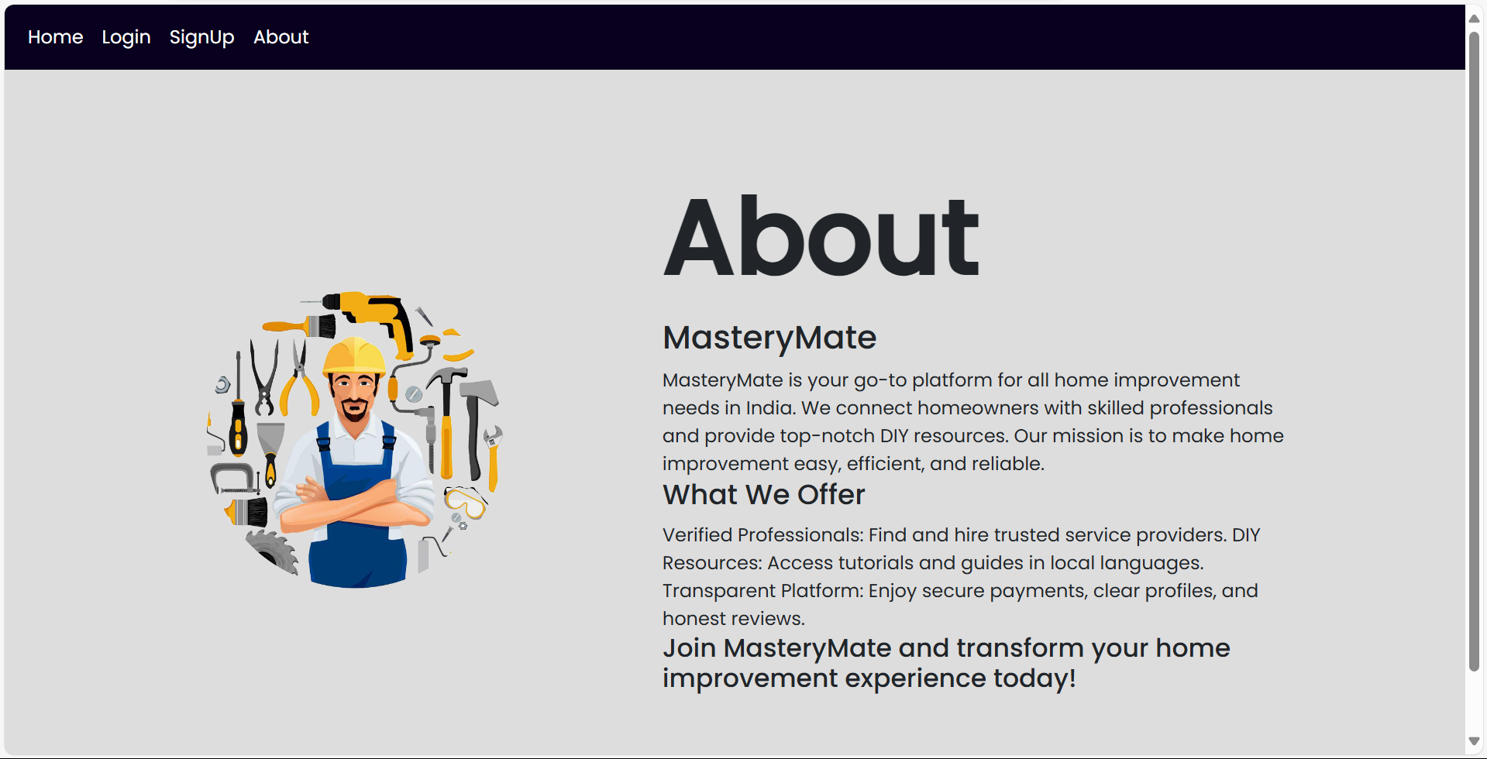
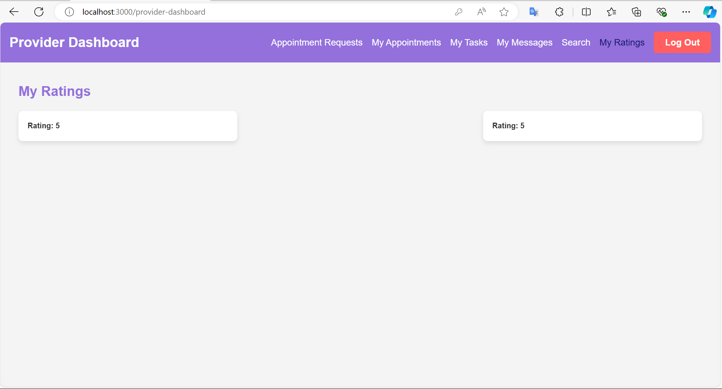
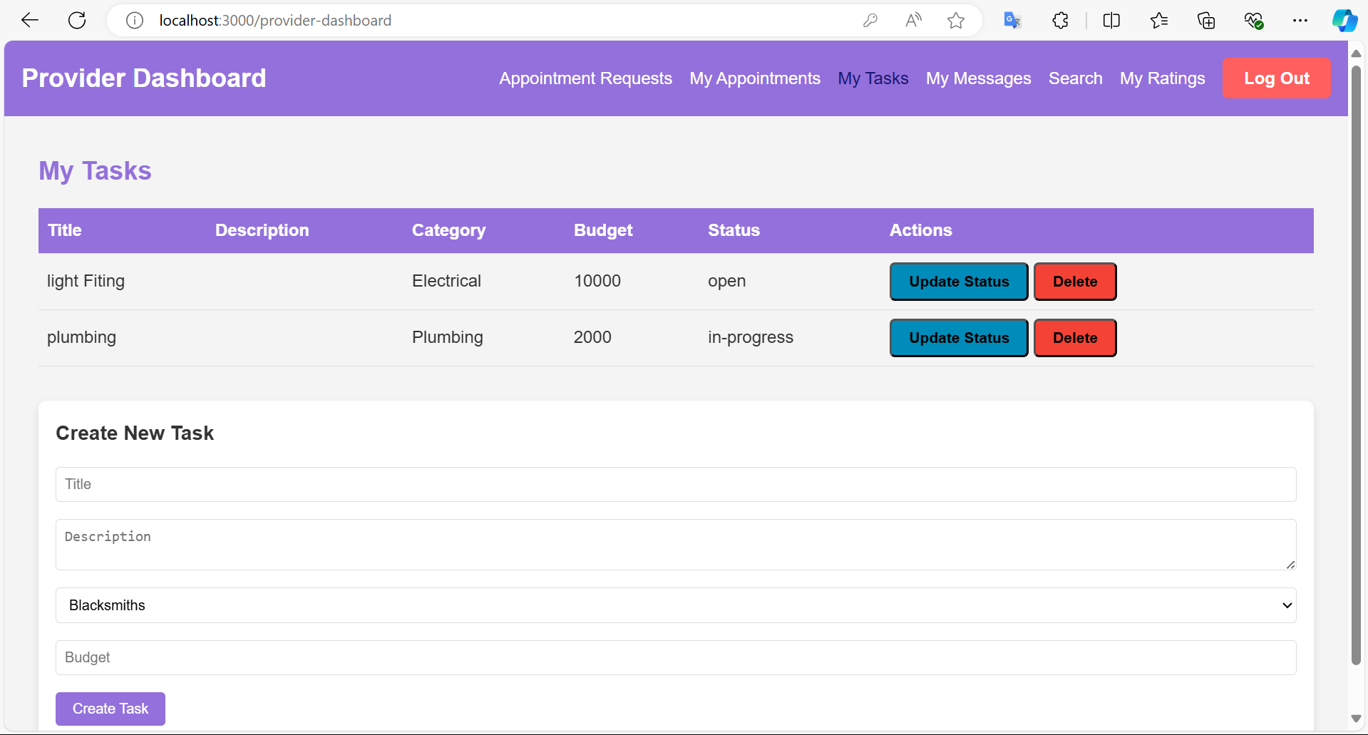
Prototype Screenshots :

Slide 8
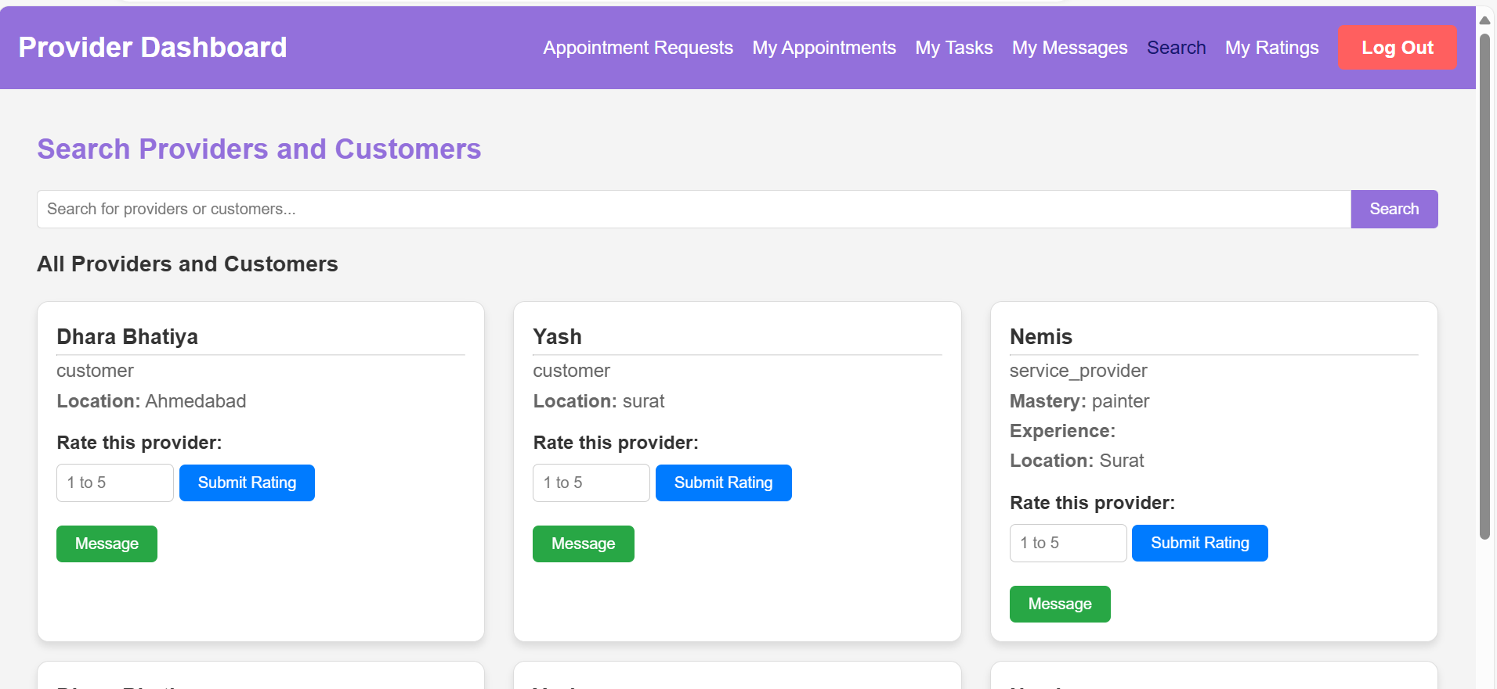
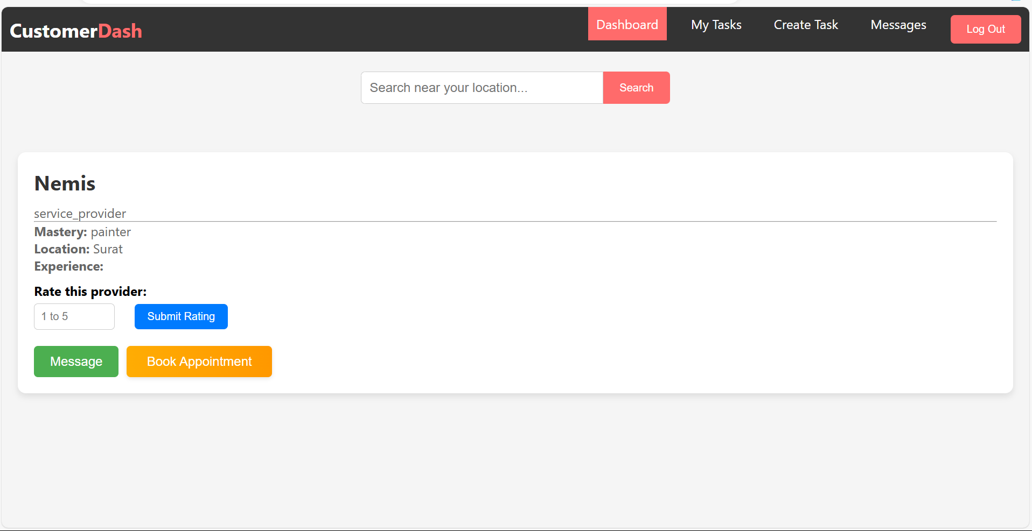
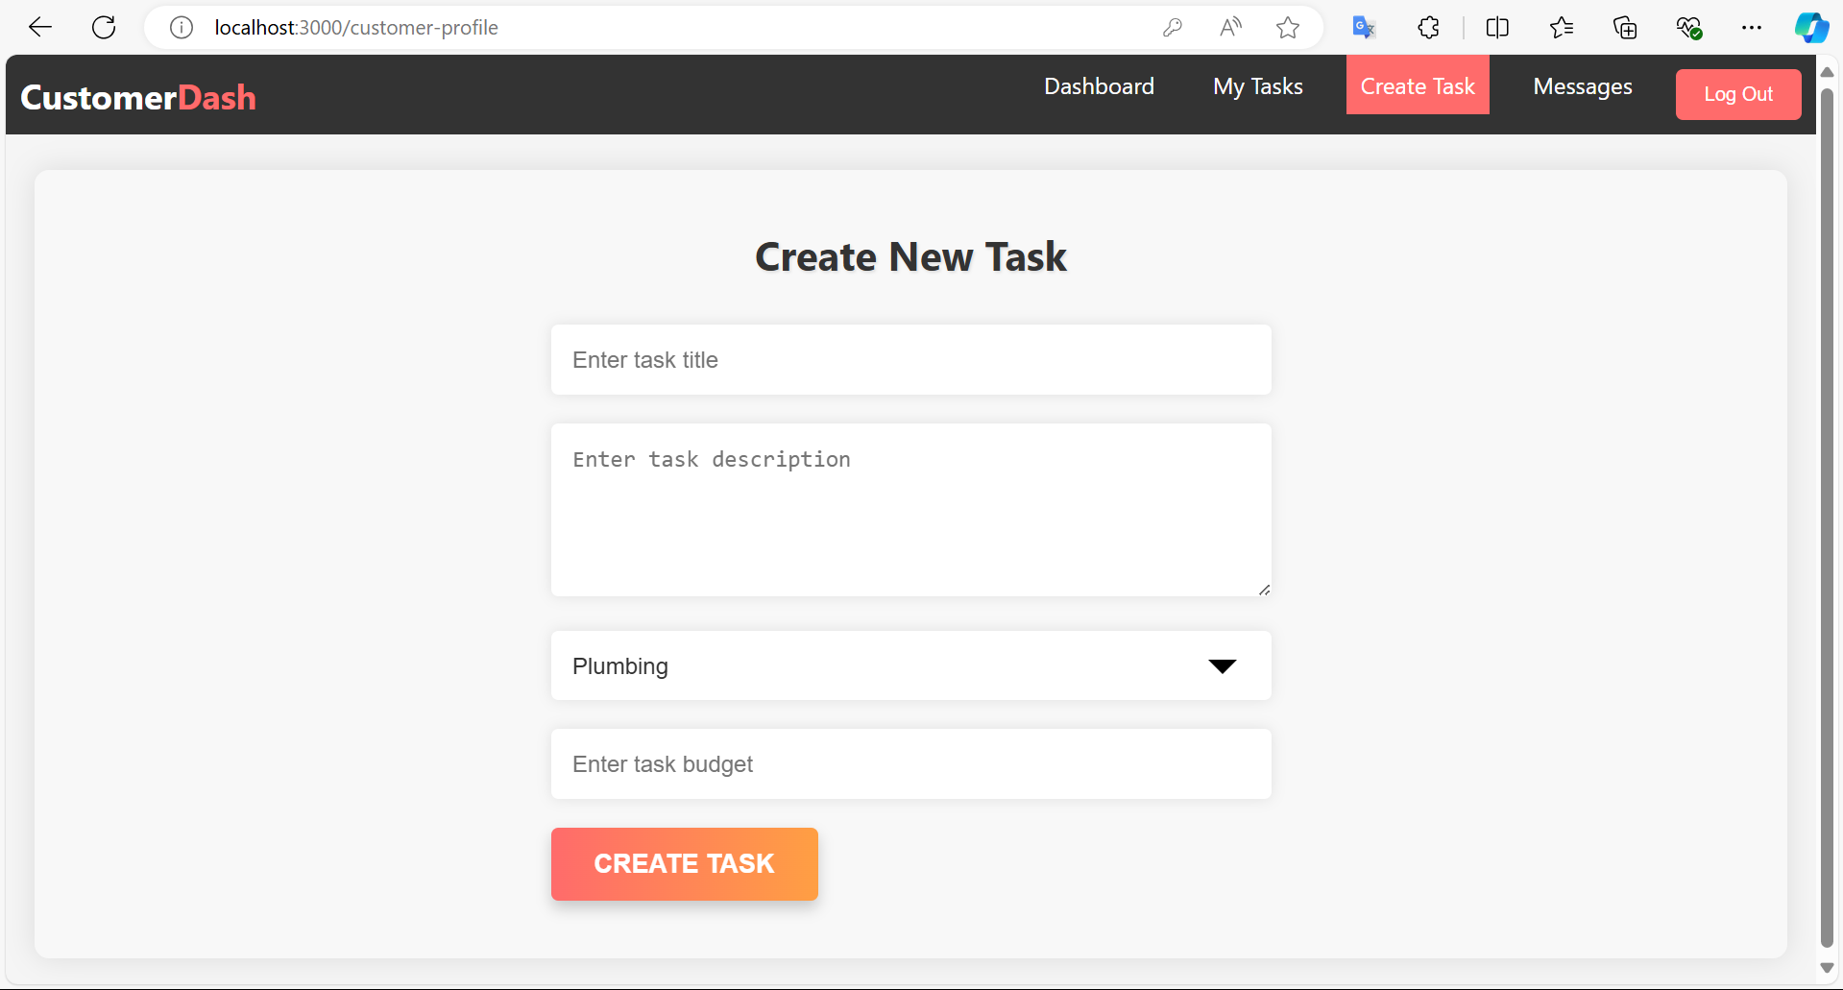
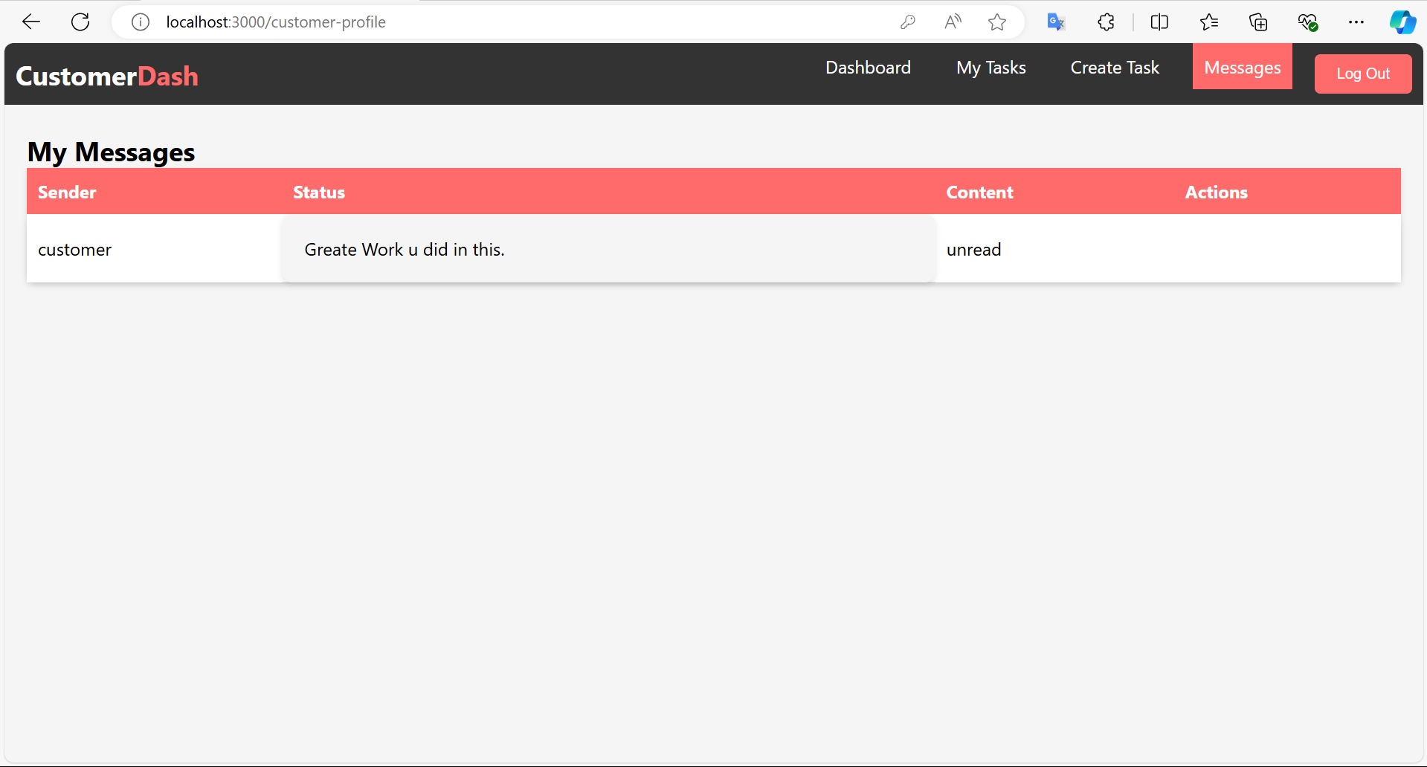
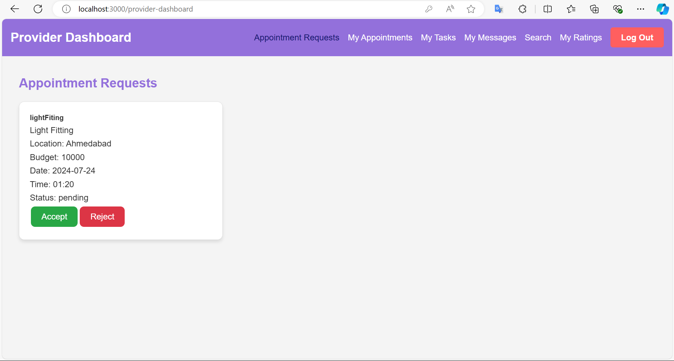
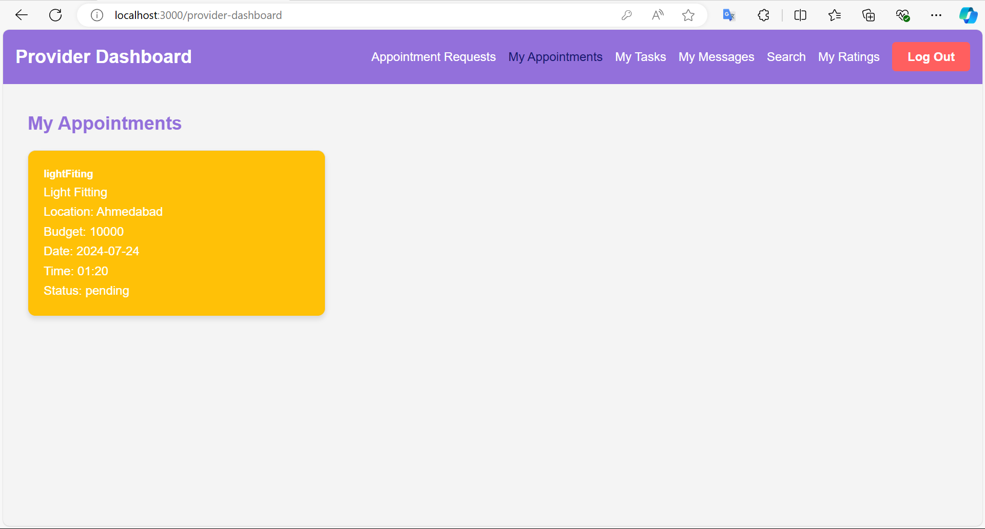
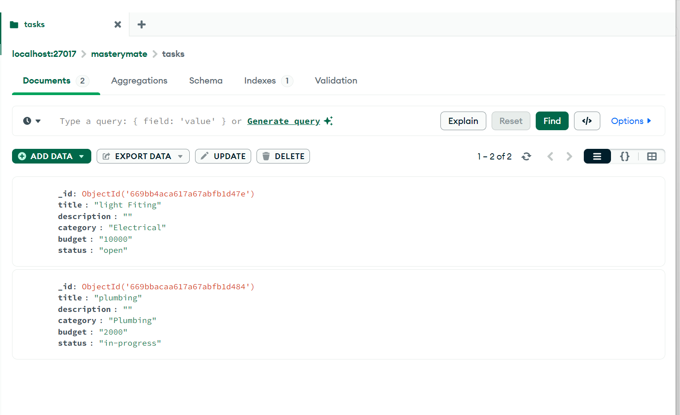
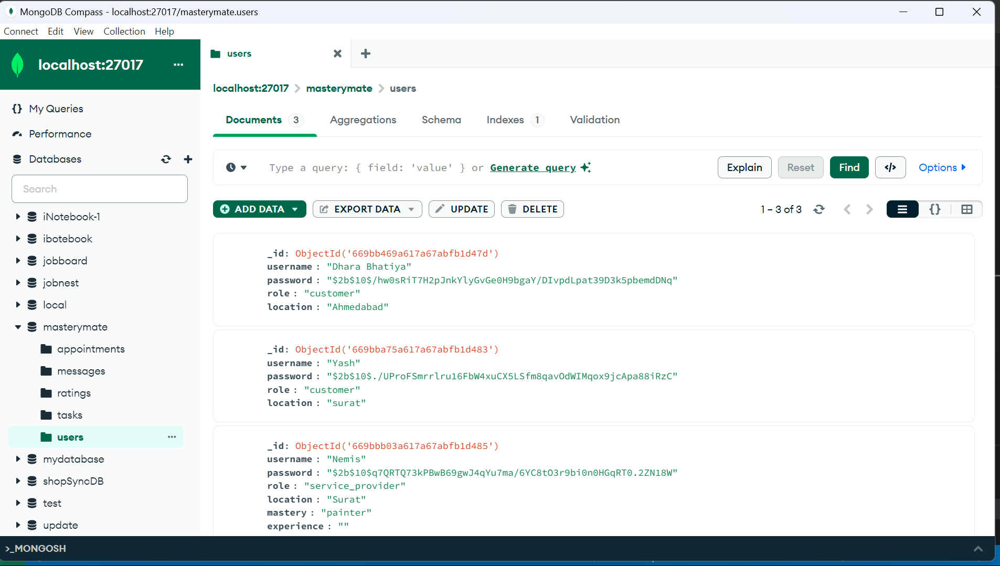
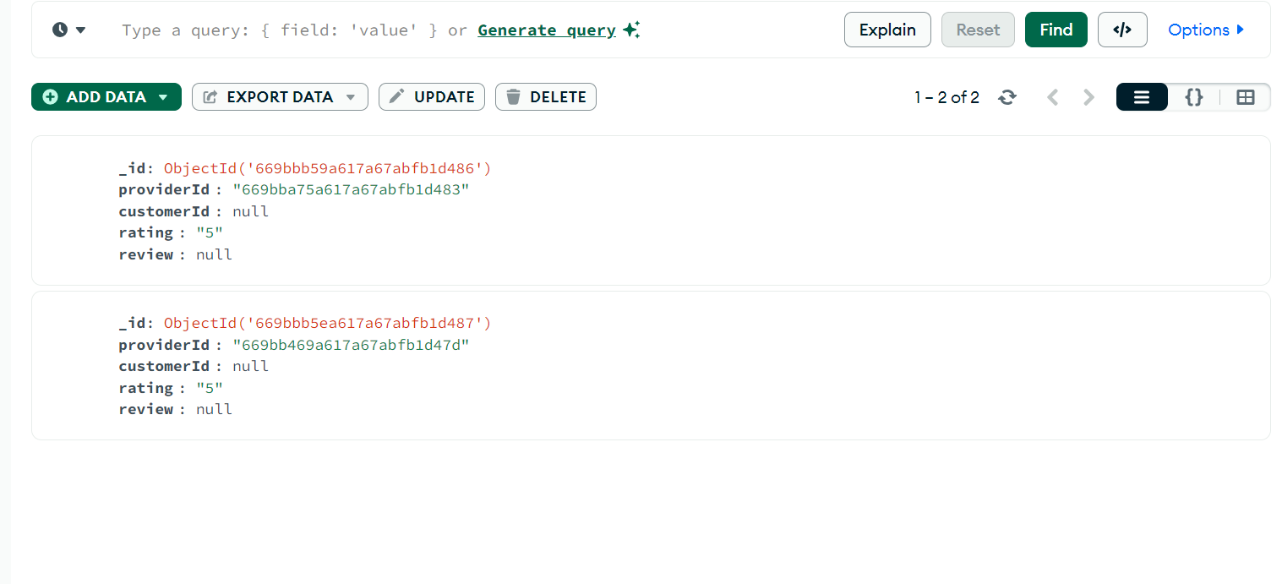

Slide 9
Front-End Development
Technologies Used
1. HTML
2. CSS
3. JavaScript
4. Node.js
5. Express.js
6. Mongo DB
Development Process
1. Rapid Prototyping
2. Initial Launch and Testing
3. Iteration and Improvement
Accessibility Considerations
1. User-Friendly Interface
2. Screen Reader Support
3. Keyboard Navigation
Responsive Design
1. Mobile Compatibility
2. Tablet Compatibility
3. Desktop Compatibility

Slide 10
Data Integration
Sources of Data
1. User Data
2. Service Provider Profiles
3. Ratings and Reviews
APIs or Open Datasets Used
1. Google Maps API for location services
2. Payment Gateway APIs for secure transactions
3. Communication APIs
Data Display and Insights
1. User Dashboards
2. Service Provider Performance Metrics
3. Ratings and Reviews Analytics

Slide 11
Testing and Optimization
Performance Testing
1. Load Testing
2. Stress Testing
3. Speed Analysis
4. Resource Monitoring
Optimization Strategies
1.Code Minification
2. Database Indexing
3. Caching Strategies
4. Continuous Monitoring and Scaling
Usability Testing
1. User Interface Feedback
2. Task-Based Scenarios
3. A/B Testing
4. Accessibility Checks
Functionality Testing
1. End-to-End Testing
2. API Integration Testing
3. Cross-Browser Testing
4. Mobile Responsiveness Testing

Slide 12
Deployment
Live Website URL :
Hosting Platform Used
1. GitHub Pages
2. Netlify
3. Vercel
Deployment Process
1. Continuous Integration (CI)
2. Continuous Deployment (CD)
3. Environment Configuration
4. Monitoring and Logging

Slide 13
Documentation
Development Process Documentation
1. Agile Methodology
2. Sprint Planning
3. Retrospectives
Design Decisions
1. User-Centered Design
2. Mobile-First Approach
3. Accessibility Standards
Implementation Steps
1. User Authentication Setup
2. Database Schema Design
3. API Integration

Slide 14
Conclusion :-
Summary of the Project
1. Project Overview
2. Key Objectives
3. Major Achievements
Impact of the Web Solution
1. User Adoption Rates
2. Customer Feedback
3. Business Benefits
Future Enhancements
1. Feature Expansion
2. Performance Improvements
3. User Experience Enhancements

Slide 15
References
Data Sources
1. User Interaction Data
2. Service Provider Activity Data
3. Transaction Records
Tools and Software Used
1. Development Tools (e.g., VS Code, Git)
2. Design Tools (e.g., Figma, Adobe XD)
3. Testing Tools (e.g., Selenium, JUnit)
Additional References
1. API Documentation
2. Industry Standards
3. Relevant Research Papers

Slide 16
Thank You

